Slide 1
2.1 Decomposition model
ESTP Training
05-07 October 2026

Slide 2
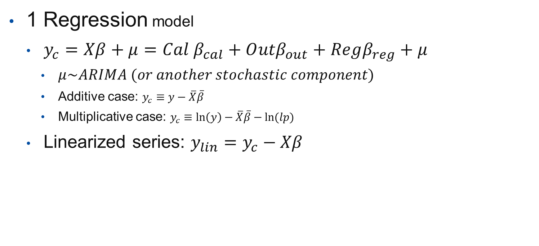
1 Two-steps models (Tramo-Seats, X12)
1 Regression model
  $y_{c}=Xβ+μ=Cal β_{cal}+O{utβ}_{out}+Regβ_{reg}+μ$
    $μ\sim ARIMA (or another stochastic component)$
    Additive case: $y_{c}≡y−\overline{X}\overline{β}$
    Multiplicative case: $y_{c}≡\ln\left(y\right)−\overline{X}\overline{β}−ln⁡(lp)$
  Linearized series: $y_{lin}=y_{c}−Xβ$

Slide 3
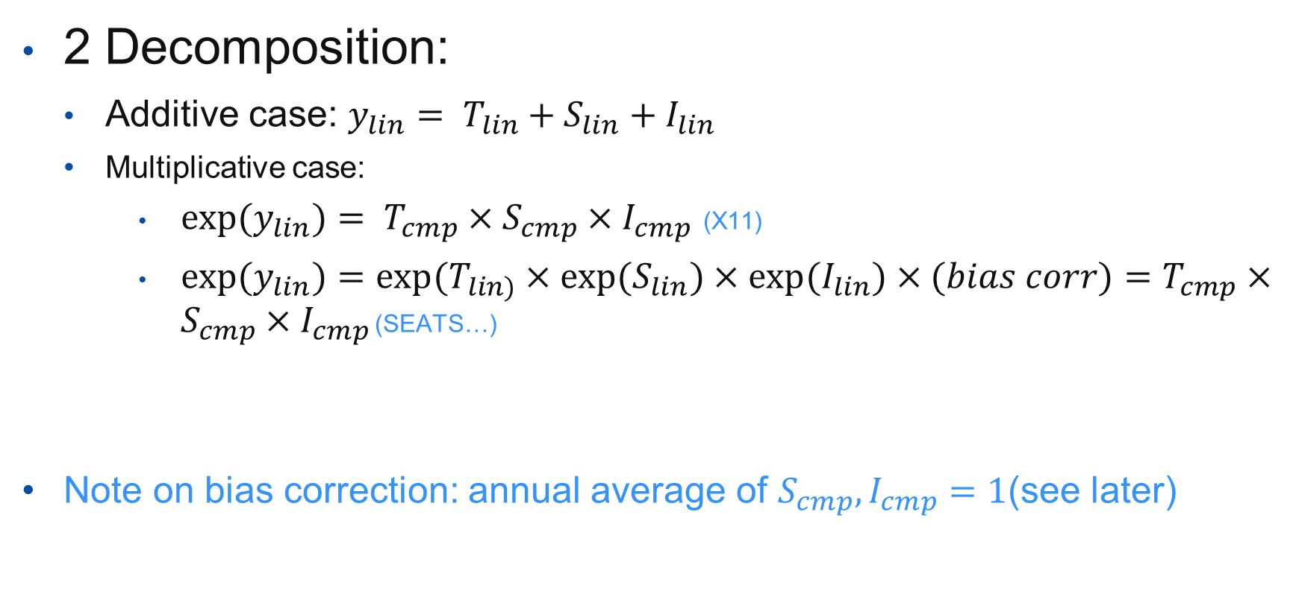
1 Two-steps models
2 Decomposition:
  Additive case: $y_{lin}= T_{lin}+S_{lin}+I_{lin}$
  Multiplicative case:
      $exp(y_{lin})= T_{cmp}×S_{cmp}×I_{cmp}$ (X11)
      $exp(y_{lin})=exp⁡(T_{lin)}×{exp⁡(S}_{lin})×{exp⁡(I}_{lin})×(bias corr)=$ $T_{cmp}×S_{cmp}×I_{cmp}$ (SEATS…)
Note on bias correction: annual average of $S_{cmp},I_{cmp}=1$(see later)

Slide 4

2 Final decomposition
Additive case:
  $t=t_{lin}{+ Out}_{t}+ {Reg}_{t}$
  $s=s_{lin}+Cal+{Out}_{s}+ {Reg}_{s}$
  $i=i_{lin}+{Out}_{i}+ {Reg}_{i}$
  $sa=t+i=y_{c}−s$
Multiplicative case:
  $t=t_{cmp}∙exp\left({Out}_{t}∙ {Reg}_{t}\right)$
  $s=s_{cmp}∙exp\left(lp∙Cal∙{Out}_{s}∙ {Reg}_{s}\right)$
  $i=i_{cmp}∙exp\left({Out}_{i}∙ {Reg}_{i}\right)$
  $sa=t∙i=y_{c}/s$

Slide 5
SA_lin
LS
reg_trend, ramps
T_lin
T
SA
AO + TC
reg_i
I_lin
I
TD + Hol
SO [+ SLS]
reg_s
S_lin
S
Deterministic effects
Stochastic components

